Slide 1
Money-Lawndering
Dev:
Sam Johnson
Xander Matheson
Andrew Peterson
Tom Waite

Slide 2
Major Design Decisions
Re-use of pages
Bootstrap
Django

Slide 3
Re-Use of Pages
We decided to reuse pages for the customers, workers, and admin. This was very beneficial to us as it let us reuse a lot of code and not have to write as much on the backend. Overall, this saved us a lot of time in developing the website and allowed us to spend more time styling the website.

Slide 4
Bootstrap
Using Bootstrap was a decision that we made due to having inconsistent-looking pages throughout the website from different people working on different pages. With the use of Bootstrap, we were able to unify our website’s styling. It was important to us that the website looked uniform so that it creates a more user-friendly experience.

Slide 5
Django
We decided right from the beginning that we were going to use Django. We came to this decision because it was what we were all most familiar with. This has turned out to be a huge benefit as it has allowed all of us to focus on coding and working on the project without any of us having to learn new technologies. This greatly increased our productivity while also making it easier for us to quickly scaffold our website to meet the requirements.

Slide 6
Agile
Using agile practices really helped our team out with our development as it allowed us to set short term goals for each sprint and then reassess at the end of the sprint to see if we were headed in the right direction, or if we needed to make any small changes to reach the customer’s requirements. It was also really helpful for us to do daily stand up meetings as we were all able to remain coordinated on who was doing what and what still needed to be done. Overall, using agile practices was an important and extremely beneficial move for our team.

Slide 7
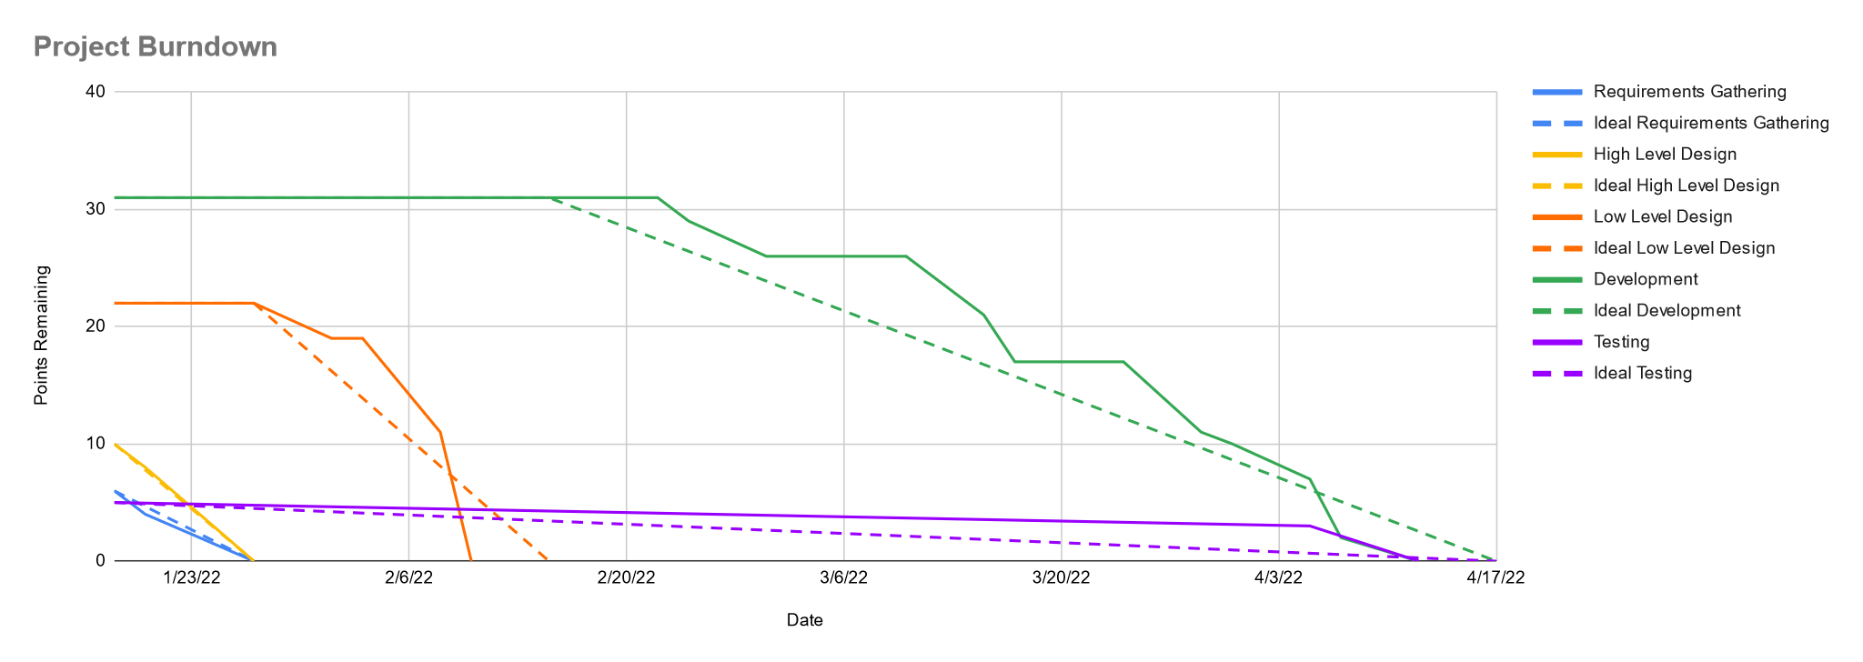
Project Burndown Chart

Slide 8
Sprint Velocities
Project Velocity (Points / Sprint) - 12.333
Milestone 1 Velocity - 1.143
Milestone 2 Velocity - 1.571
Milestone 3
Sprint 1 Velocity - 0.643
Sprint 2 Velocity - 0.571
Sprint 3 Velocity - 0.5
Milestone 4 Velocity - 0.5

Slide 9
Deployment
As a group, we think that the project is ready for deployment. It meets all requirements specified by the user which we verified by performing large amounts of unit testing and use case testing. Overall, we think the customer will be pleased with the final product. We feel that we designed our project well enough that if the customer does want extra features or wants us to modify or remove existing features, it won’t negatively impact the rest of the project.

Slide 10
Requirements
User-Authentication
Worker Features
Customer Features

Slide 11
User-Authentication Requirements
The system will require all users to log in in order to view their account and associated info
Upon logging in for the first time, users will provide a valid email address and password for future login.
Additionally, they must specify or provide the following:
Whether they intend to use the service primarily as a worker or as a customer.
A valid payment method to use the service.
A neighborhood or street address.
a phone number.
A username
For future login attempts, the system will require users to provide their email address and password which the system will then either validate and grant access to the account, or invalidate and allow the user another chance to log in.
Should the attempt to login fail, the system will make no indication of whether the email address was incorrect or the password was incorrect, simply that one or both was incorrect. This is for security.
The system will prevent the same email address from being used in multiple accounts

Slide 12
User-Authentication Scrum Tasks
Create login activity diagram - Andrew
Low fidelity prototypes - Xander
High fidelity prototype - Tom
Create models - Andrew
Create views for login and signup and update urls.py - Tom
Create html template for sign up page - Tom
Create html template for login page - Tom
Create login and sign up pages - Sam
Create CSS styling for site - Xander

Slide 13
User-Authentication Prototypes and Diagrams

Slide 14

Money LAWNdering
Username
Password
Sign Up
Sign In
What the community is saying right now:
5/5 Stars! Best Lawn Care Ever!
-Dora T. E.
110% - I’m rich now! It was easy!
-Jimothy
10/10 - I made that kid rich lolol!
-Walter

Slide 15

Alright, let’s get you signed up!
Remember to provide accurate information
so you can get the most out of this service!
Username
Username
Username
Phone Number
Password
Email
Confirm Password
Confirm Email
Street Address
City, State
Zip Code
Bank (Yes or No)
I want yard work done
I want to do yard work
By clicking Sign Up, you agree to nothing.
Sign Up

Slide 16
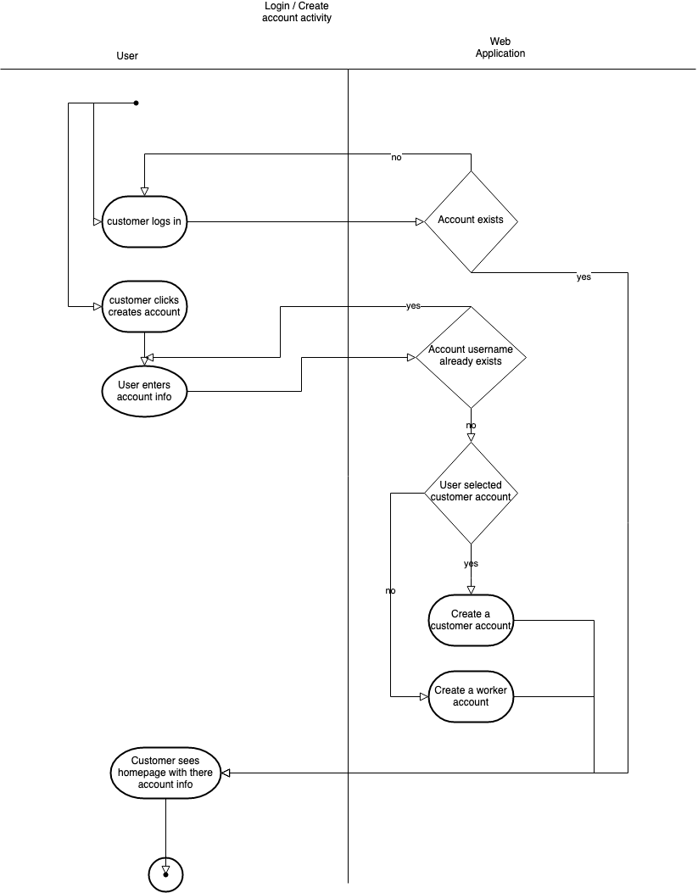

Slide 17
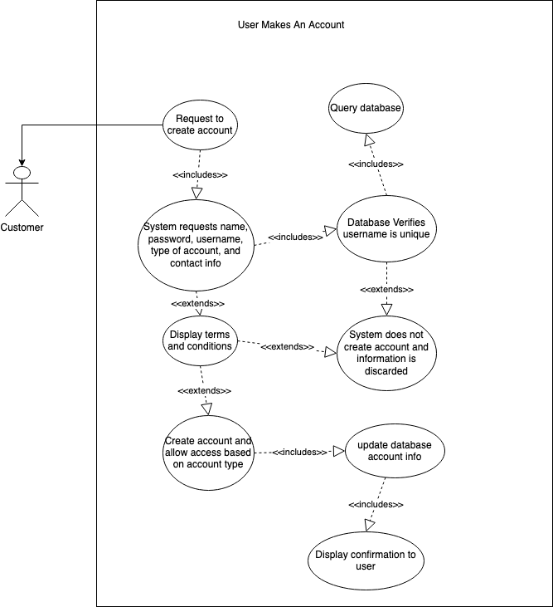
Entry Conditions:
User wants to create an account
Exit Conditions:
Account is created
User rejects terms and account is not created
Event Flow:
User requests to create account
System requests Username, password, email address, phone number, address, and account type
System displays terms and conditions
If User accepts, account is created
If User declines, account is not created

Slide 18
User-Authentication Testing
Two unit test classes for user-authentication
Can be run by using “python manage.py test”
SignInTest
testAcceptValidUser - Tests if a valid customer/worker can login
testAcceptValidAdmin - Tests if a valid admin can login and gets redirected to admin page
testDenyUnauthorizedUser - Tests if invalid users are rejected
CreateUserTest
testCanCreateValidUser - Tests if the signup process can create a new user and redirect to account page
testRejectsExistingUser - Tests if signup will reject the creation of a duplicate account

Slide 19
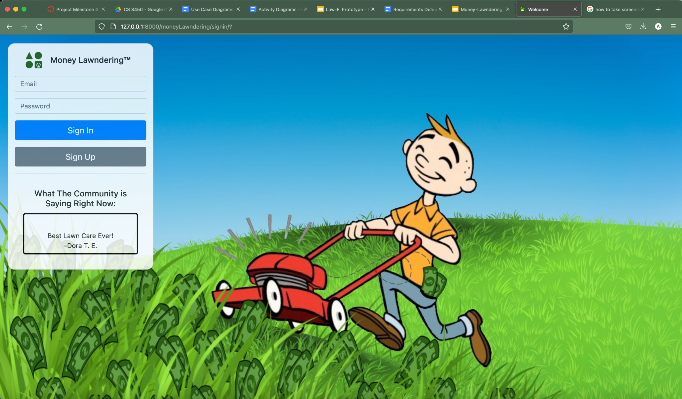
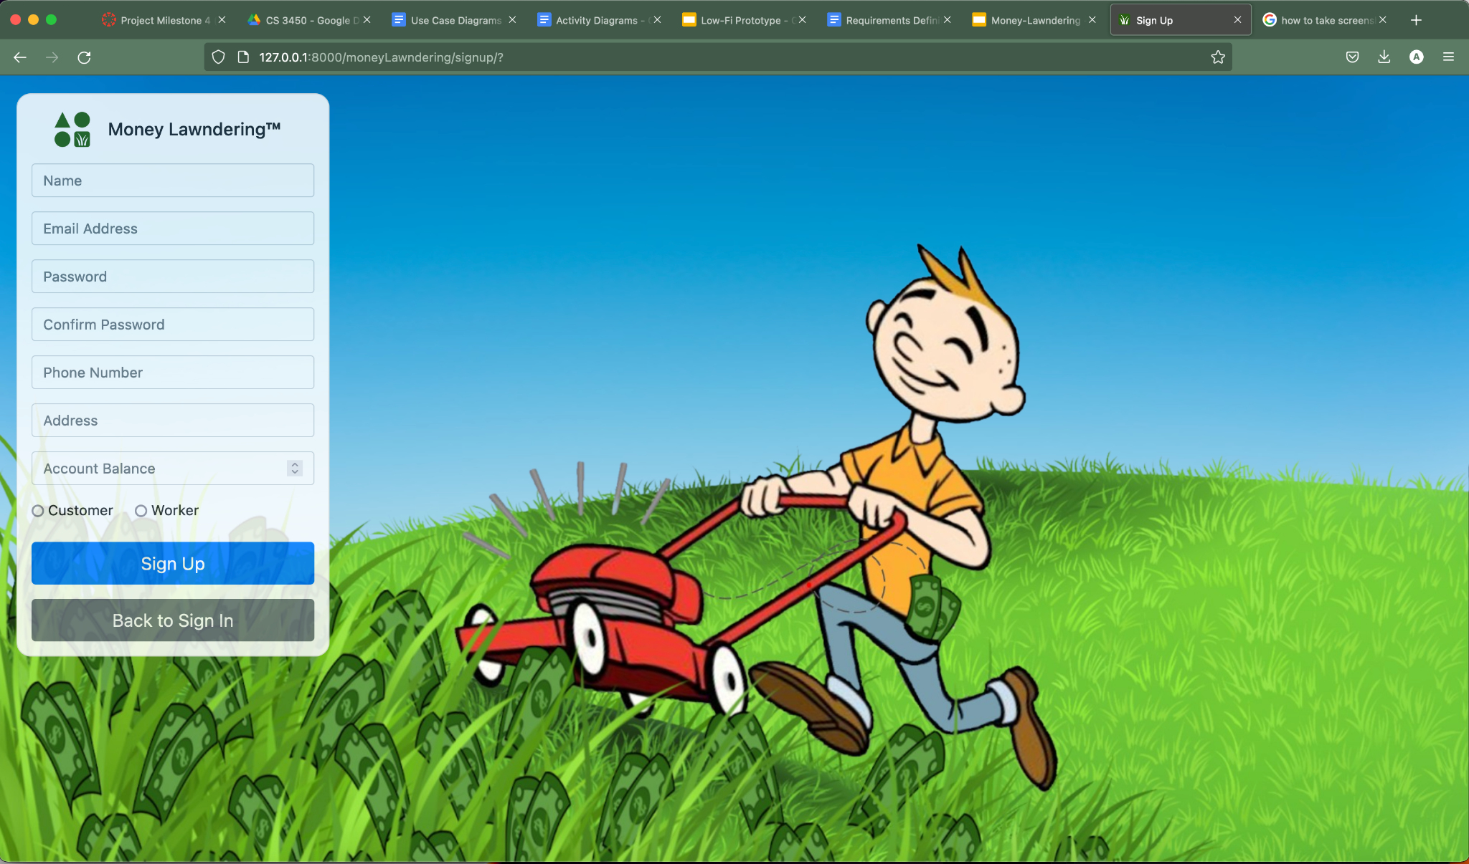
User-Authentication Implementation

Slide 20
Worker Features Requirements
All users who elect to use the service as a worker shall have access to all worker features.
The system will allow all workers to view a list of all currently active job listings
Listings will display the category of work and a price for the job
Workers may select a job listing from the list to view additional information.
The general location (zip code) of the job, the time range for the job, and the customer’s username and rating are displayed after selecting the listing.
A worker may accept a job from this view.
When a worker accepts a job and the customer accepts the worker, the worker may view that customer’s contact information to get in touch.
After completing a job, a worker can indicate they have completed the job. At this point, the worker will receive 90% of what the customer posted the job for and a notification allowing them to:
Assign a star rating to the customer
Leave a comment about the customer

Slide 21
Worker Features Scrum Task
Create login activity diagram - Andrew
Low fidelity prototypes - Xander
High fidelity prototype - Tom
Class Diagrams - Sam
Activity Diagrams - Sam
Create models - Andrew
Create CSS styling for site - Xander
Create History Page - Tom
Create Account page - Xander
Create Contact Info - Xander

Slide 22
Worker Features Prototypes and Diagrams

Slide 23

My Account
Public Listings
Your Listings
New Listing
Accepted Jobs
Direct Transfer
History
Listings
Check out these fantastic opportunities near you!
Pruning
84321
$50
Lawn Care
84302
$25
Su
M
Tu
W
Th
F
Sa
4-6 PM
~1.5 Hours
Annie
I just want my lawn mowed, but I may need some trimming too.
Accept
Spring Cleaning
84404
$35

Slide 24
My Account
Public Listings
Your Listings
New Listing
Accepted Jobs
Direct Transfer
History
Your Accepted Jobs
Remember, people appreciate speedy communication and proactivity!
Patio Work
84321
$50
Lawn Care
84302
$25
Su
M
Tu
W
Th
F
Sa
4-6 PM
~1.5 Hours
Annie
435-123-4567
I just want my lawn mowed, but I may need some trimming too.
Mark Finished!

Slide 25
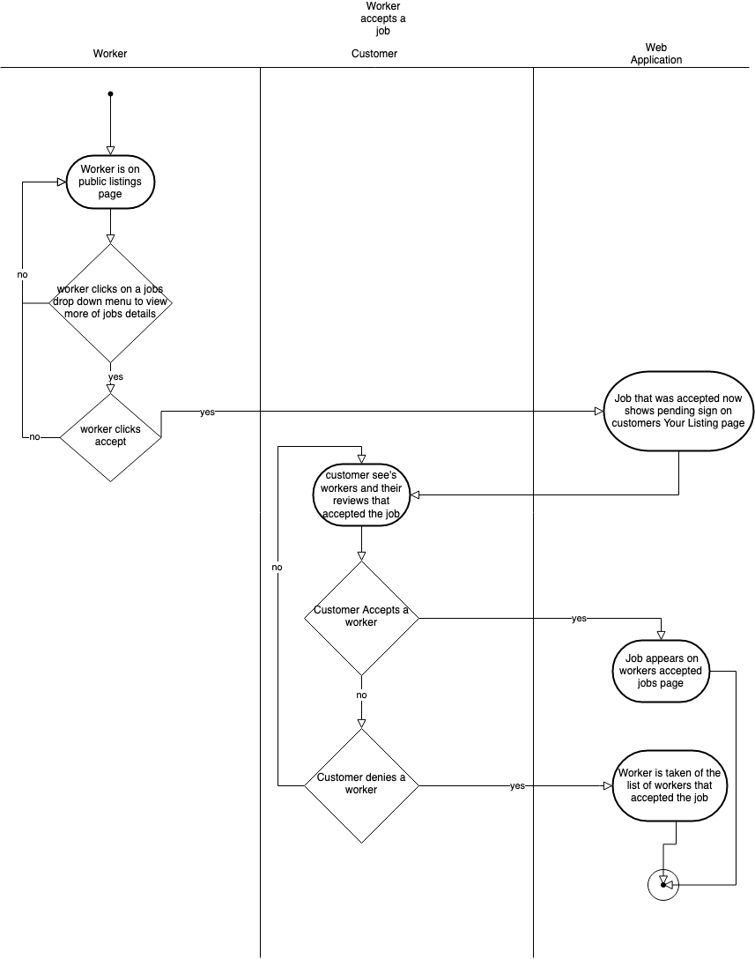

Slide 26
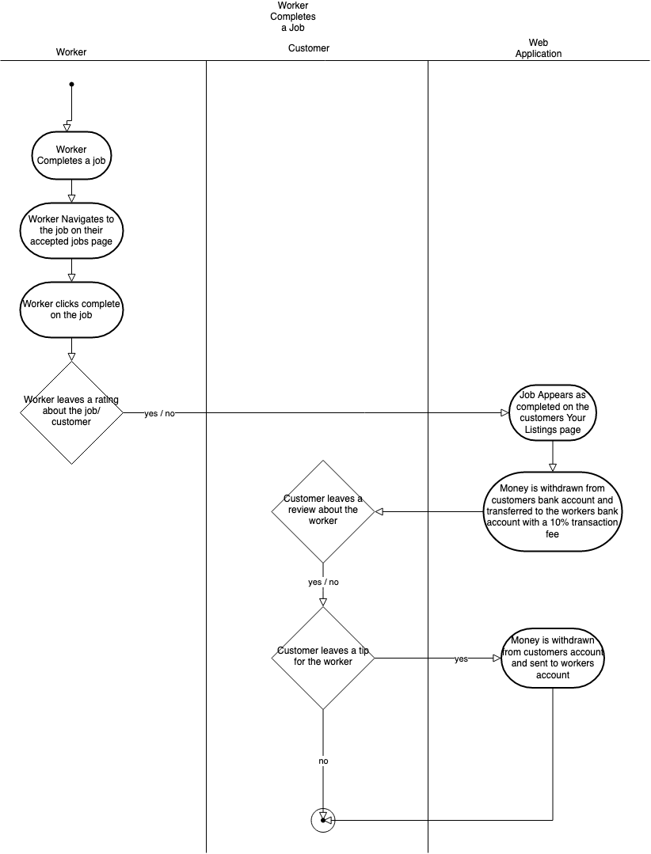

Slide 27
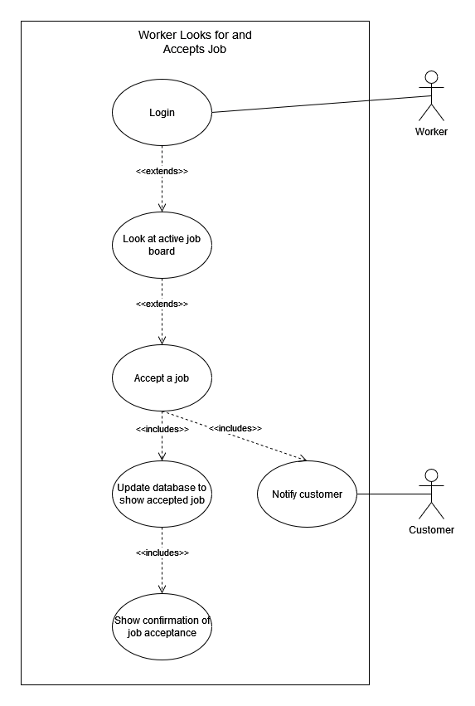
Entry Conditions:
Worker is logged in
Worker is looking for a new Job
Exit Conditions:
Worker Accepts a New Job
Event Flow:
Worker Looks at Active Job board
Worker Accepts a Job
System Updates that Worker Accepted the job in database
System Sends notification to Customer
System displays confirmation of Acceptance

Slide 28
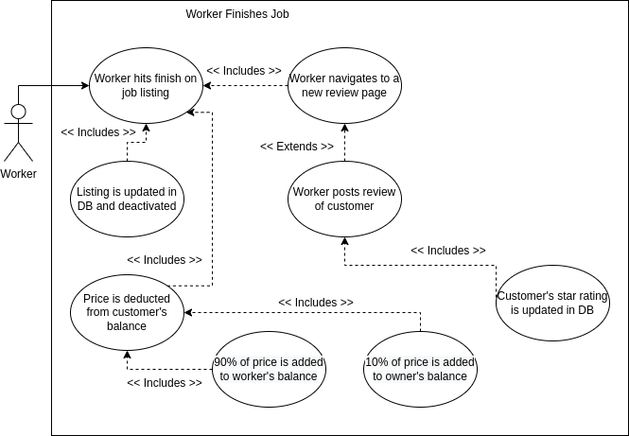
Entry Conditions:
Worker is logged in
Worker has finished job
Exit Conditions:
Worker has reviewed the job
Worker has marked the job as finished, but not reviewed it
Event Flow
Worker marks job as finished
System updates job as finished in database
System Transfers amount out of Customer account
System Transfers 10% to Owner account
System Transfers 90% to Worker account
System allows Worker option to provide feedback
Worker Chooses rating and leaves feedback
System posts review to database and updates Customer rating

Slide 29
Worker Features Testing
One unit test class for worker features
Can be run using: “python manage.py test”
UpdateUserTest
testValidUpdate - Test if updating user account info is done properly
AcceptListingTest
testAcceptExistingListing - Tests if the worker can accept an open listing
testAcceptNonexistentListing - Tests if the page returns a 404 when the worker tries to accept a listing without a real id

Slide 30
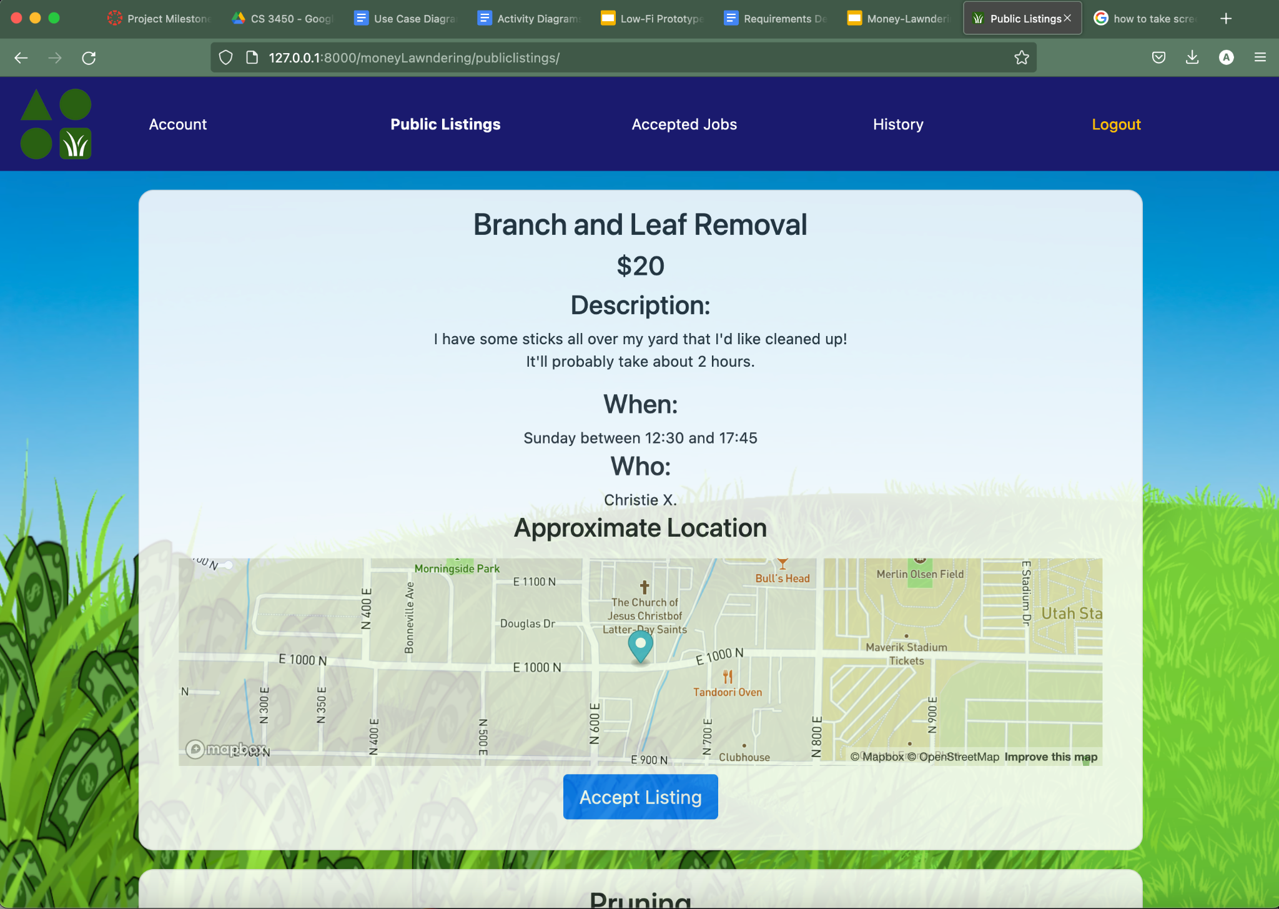
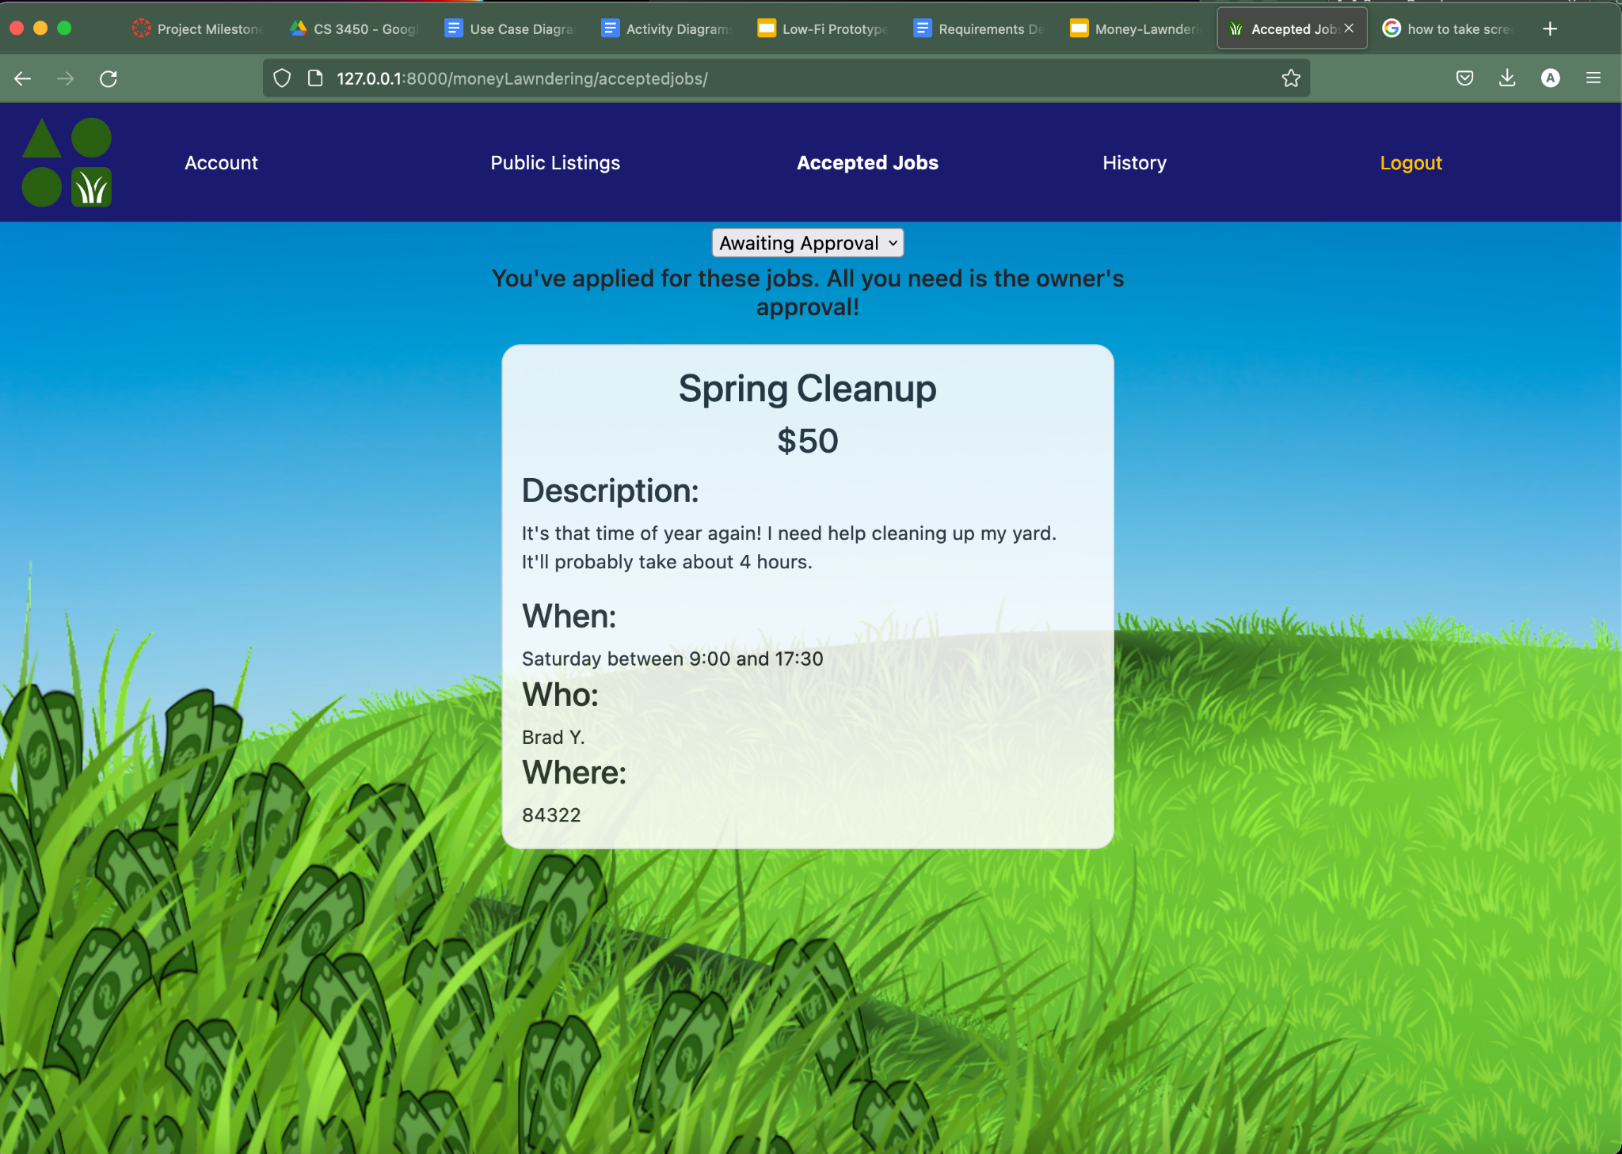
Worker Features Implementation

Slide 31
Customer Features Requirements
All users who elect to use the service as a customer shall have access to all customer features.
The system will allow all users with customer access the opportunity to create a new job listing.
Upon listing a job, the customer must specify their estimated time to complete the job, a desired day of the week and time of day, a category, and a fixed amount they intend to pay for completion of the job.
Customers will be able to see all of their listings and edit any of them prior to them being accepted by a worker.
The customer may deactivate any listing at any time prior to it being accepted by a worker.
Customers may search for any worker’s username and send them money at any time with a 1% fee being deducted from the amount and sent to the owner’s balance.
When a worker accepts a job and the customer accepts the worker, the customer may view that worker’s contact information to get in touch.
After a worker claims to have finished a job, the advertised listing price is deducted from the owner’s account and transferred to the worker’s balance with a 10% fee being deducted from the amount and sent to the owner’s account balance. Additionally, the customer will receive a notification prompting them to elect:
To assign a star rating to the worker.
Leave a review for the worker

Slide 32
Customer Features Scrum Tasks
Create login activity diagram - Andrew
Low fidelity prototypes - Xander
High fidelity prototype - Tom
Class Diagrams - Sam
Activity Diagrams - Sam
Create models - Andrew
Create CSS styling for site - Xander
Create History Page - Tom
Create Account page - Xander
Create Contact Info - Xander

Slide 33
Customer Features Prototypes and Diagrams

Slide 34
My Account
Public Listings
Your Listings
New Listing
Accepted Jobs
Direct Transfer
History
Create / Edit
a Listing
If you need a job done sooner rather than later, try raising your price!
Type
Price
Su
M
Tu
W
Th
F
Sa
Time of Day
Estimated Time to Complete
Description
Cancel
Submit

Slide 35
My Account
Public Listings
Your Listings
New Listing
Accepted Jobs
Direct Transfer
History
Your Listings
Check back frequently to see who’s ready to get to work!
Pruning
Closed, Awaiting Review
$50
Lawn Care
Open
$25
Su
M
Tu
W
Th
F
Sa
4-6 PM
~1.5 Hours
4/25
I just want my lawn mowed, but I may need some trimming too.
Edit/
Delete
Spring Cleaning
Accepted, Pending
$35

Slide 36
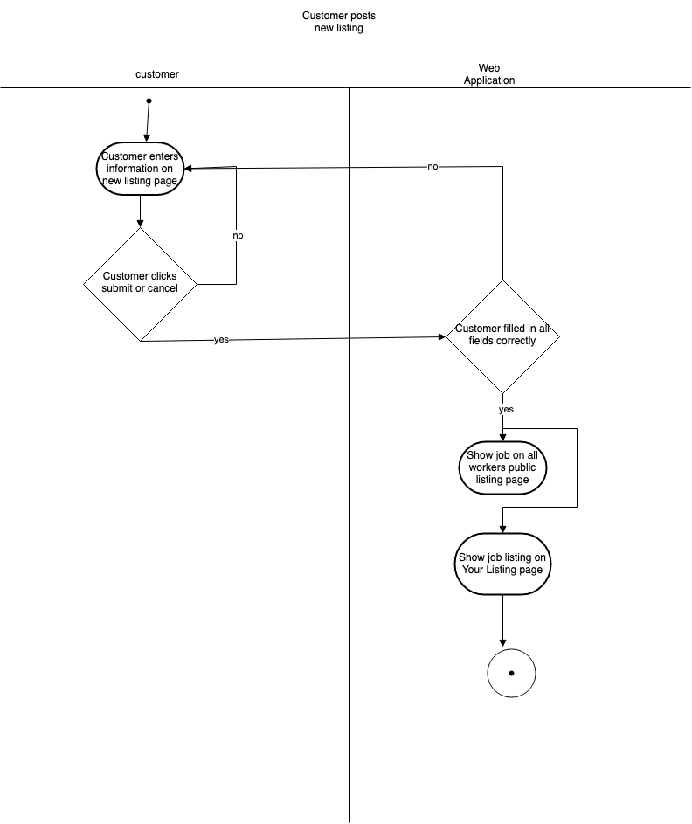

Slide 37
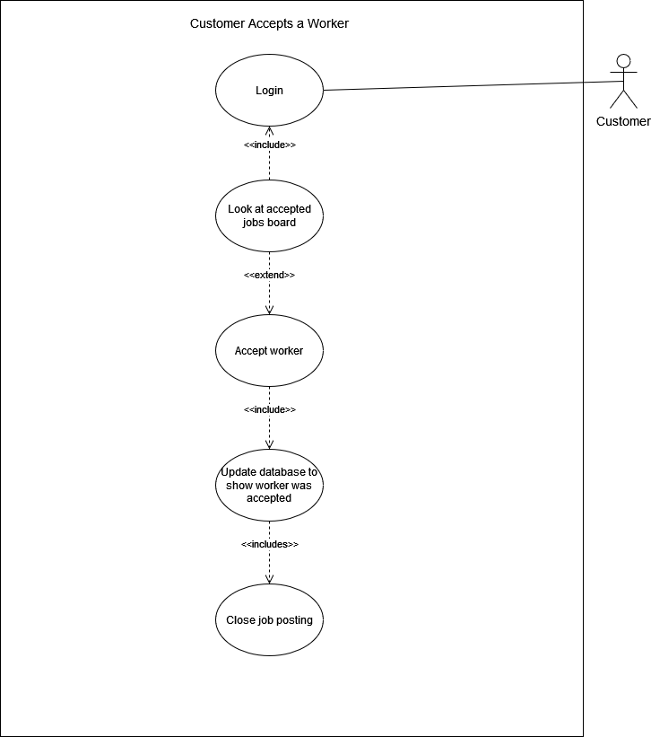
Entry Conditions:
Customer is logged in
Exit Conditions:
Customer Accepts Worker
Event Flow:
Customer Looks at Accepted Job board
Customer Goes to the applicant page
Customer Accepts Worker

Slide 38
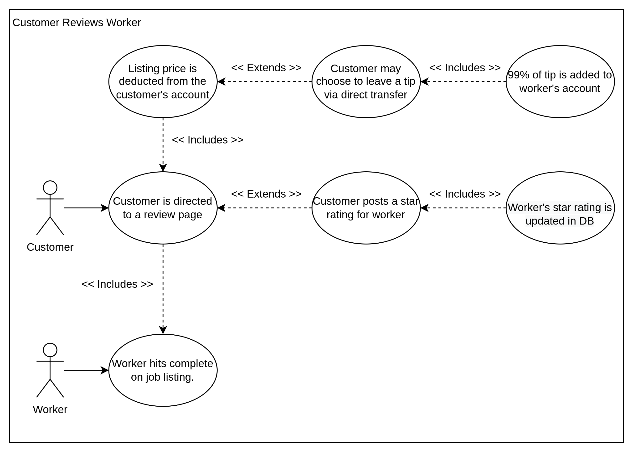
Entry Conditions:
Customer is logged in
Worker has marked job as finished
Exit Conditions:
Job is reviewed
Event Flow:
Customer finds Job
Customer Chooses rating
Customer leaves feedback
System asks if Customer wants to leave a tip
Customer chooses tip amount (Can be 0)
System posts review to database
System transfers tip to Worker
System updates Worker rating

Slide 39
Customer Features Testing
Two unit test classes for customer features
Can be run by using: “python manage.py test”
UpdateUserTest
testValidUpdate - tests if update of account info was performed successfully
ListingsTest
testvalidNewListing - tests if valid input produces a new listing
testInsufficientFundsForListing - tests if customers with insufficient funds are rejected from creating listing
testInvalidNewListing - tests if a missing field is handled correctly
testDeleteListing - tests if customer can successfully delete listing

Slide 40
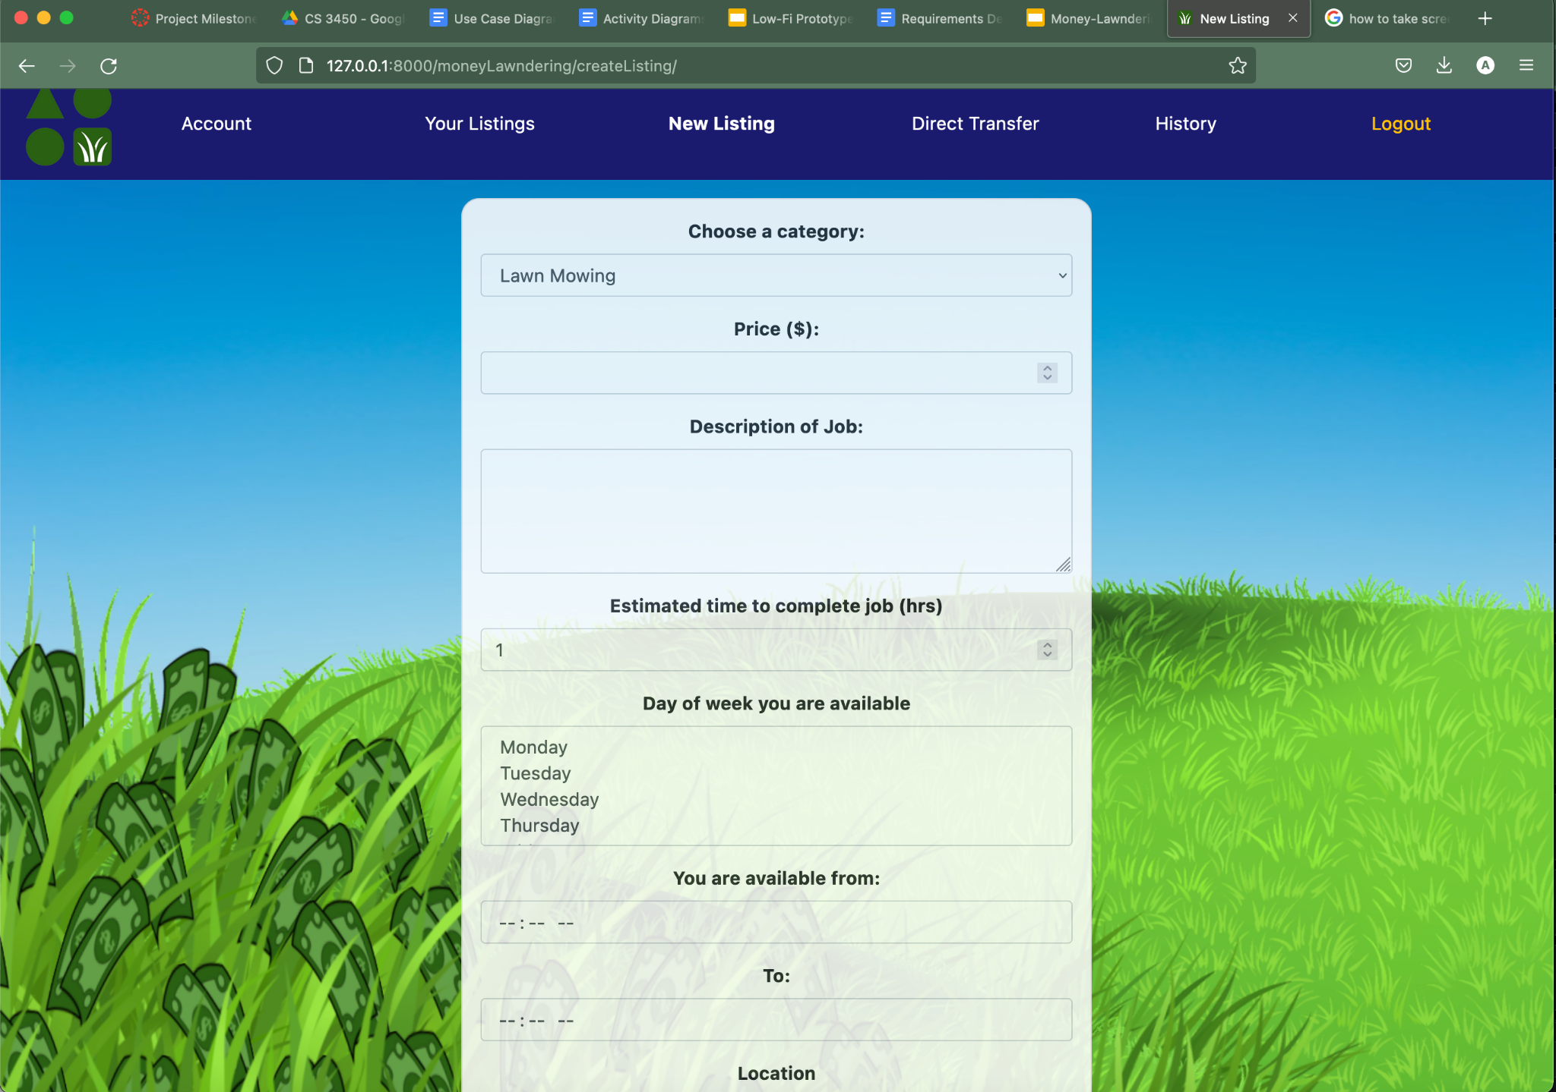
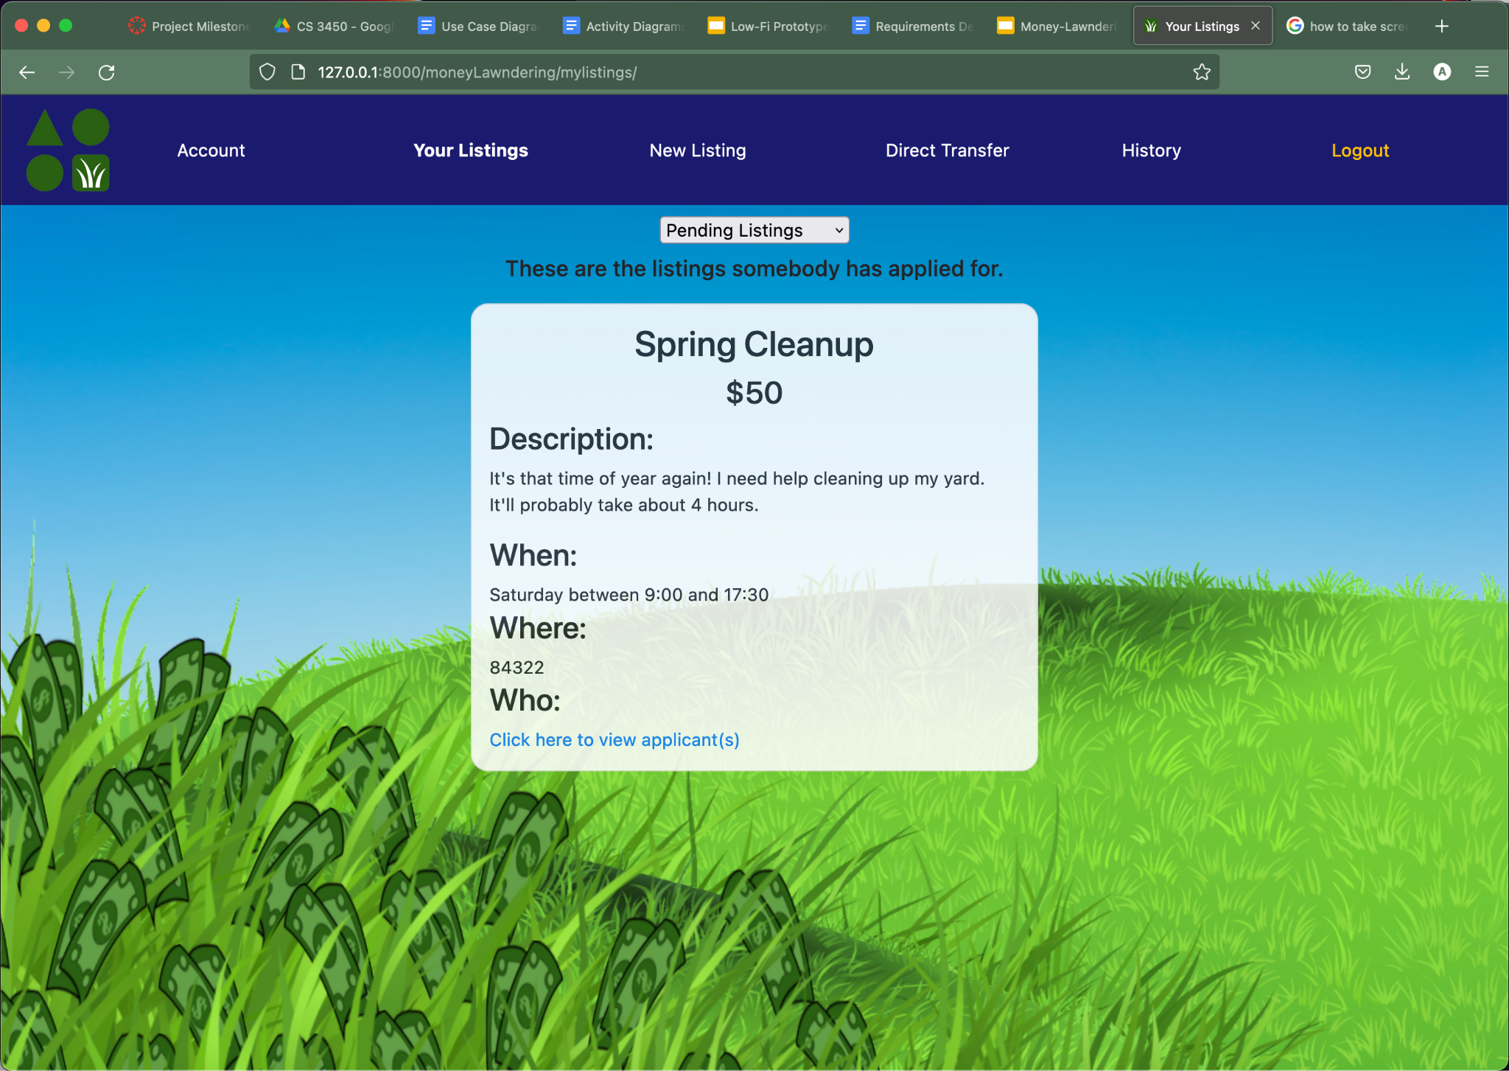
Customer Features Implementation

Slide 41
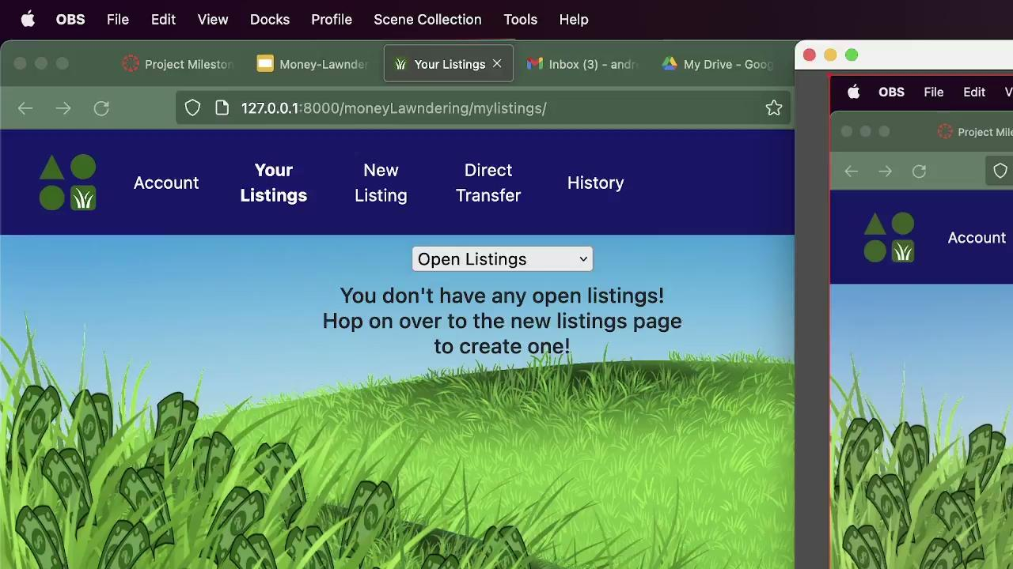
Use Case #3 Demo

Slide 42

Use Case #4 Demo

Slide 43
Use Case #6 Demo

Slide 44
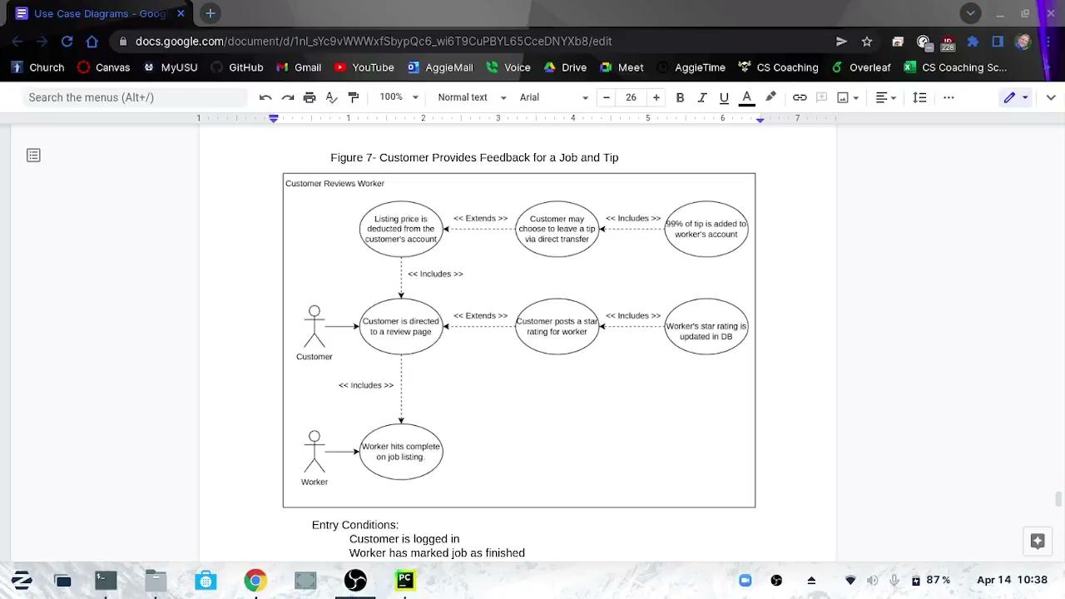
Use Case #7 Demo

Slide 45
Resources
5 star rating with CSS and HTML - CodePen. (n.d.). Retrieved April 14, 2022, from https://codepen.io/hesguru/pen/BaybqXv
Documentation. Django. (n.d.). Retrieved April 14, 2022, from https://docs.Djangoproject.com/en/3.2/intro/tutorial01/
Documentation. Mapbox. (n.d.). Retrieved April 14, 2022, from https://docs.mapbox.com/
HTML: Hypertext markup language. MDN. (n.d.). Retrieved April 14, 2022, from https://developer.mozilla.org/en-US/docs/Web/HTML
Juviler, J. (2021, September 9). How to create scrolling text with CSS [+ code templates]. HubSpot Blog. Retrieved April 14, 2022, from https://blog.hubspot.com/website/scrolling-text-css
Mark Otto, J. T. (n.d.). Introduction. · Bootstrap v5.1. Retrieved April 14, 2022, from https://getBootstrap.com/docs/5.1/getting-started/introduction/

Slide 46
Questions?

